Slide 1
Conceptual Framework for Estimating LLIN Impact
OpenMalaria simulation model
Demography
Seasonality
Vector species
Health system access
Transmission intensity scenarios (EIR sweep)
Low EIR
Moderate EIR
High EIR
LLIN usage scenarios
Counterfactual baseline
LLIN usage=0
Non-user prevalence
0% → 80% usage
LLIN Users
Non-users
Population Stratification (0 – 100 years)
Users and non-users coexist

Slide 2


Conceptual Framework for Estimating LLIN Impact
OpenMalaria simulation model
Ghana demography
Seasonality
Vector species
Health system access
Transmission intensity scenarios (EIR sweep)
Low PfPR
Moderate PfPR
High PfPR
Population stratification (LLIN use)
Counterfactual baseline
LLIN usage=0
Non-user prevalence
Proportion of population using LLIN (0% → 80% )
Rest of the population at each usage level
LLIN Users
Non-users
Population Stratification (Age)
Users and non-users coexist
Analysis outputs
Direct protection
Prevalence reduction among LLIN users
(vs counterfactual)
Indirect protection
Prevalence reduction among non-users
(vs counterfactual)
Overall protection
Population-weighted prevalence reduction
(vs counterfactual)

Slide 3
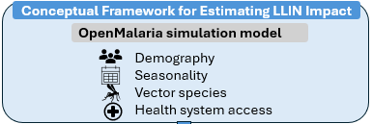
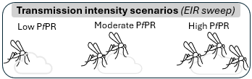
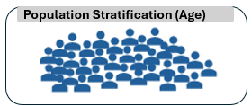
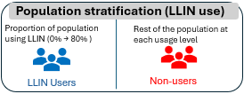
Counterfactual
Non-user prevalence at LLIN usage=0
Population
Users and non-users coexist
Analysis outputs
User protection
Prevalence reduction among LLIN users
(vs counterfactual)
Non-user (community) protection
Prevalence reduction among non-users
(vs counterfactual)

Slide 4
Conceptual Framework for Estimating LLIN Impact
OpenMalaria simulation model
Ghana demography
Seasonality
Vector species
Health system access
Transmission intensity scenarios (EIR sweep)
Low EIR
Moderate EIR
High EIR
LLIN usage scenarios
Counterfactual baseline
LLIN usage=0
Non-user prevalence
Proportion of population using LLIN (0% → 80% )
Rest of the population at each usage level
LLIN Users
Non-users
Population Stratification (0 – 100 years)
Users and non-users coexist
Analysis outputs
Direct protection
Prevalence among LLIN users
(vs counterfactual)
Indirect protection
Prevalence among non-users
(vs counterfactual)
Overall protection
Population-weighted prevalence reduction
(vs counterfactual)
Community effect
Additional benefit beyond direct protection (absolute difference between direct and overall protection)

